Slide 1
Minimum Variance Portfolio Optimization
1 October 2025
Team: Nathan Arimilli, Shahmir Javed, Joseph Bailey

Slide 2
Agenda
Portfolio Assumptions (01)
Portfolio Breakdown (02)
Portfolio Returns (03)
Portfolio Volatility & Turnover (04)
The Efficient Frontier (05)
Takeaways (06)

Slide 3
Portfolio Assumptions
Backtest period of 15 years (2010-2024)
Had a rolling window of 36 months
Our sample portfolio consists of a basket of 20 default blue-chip stocks
Maximum weights
Long positions: 100%
Short positions: (100)%
Allowed for a minimum of 36 months of data per stock and no more than 10% of data to be missing
The default risk free rate is set at 4.2% (based on the 10-year T-Note)

Slide 4
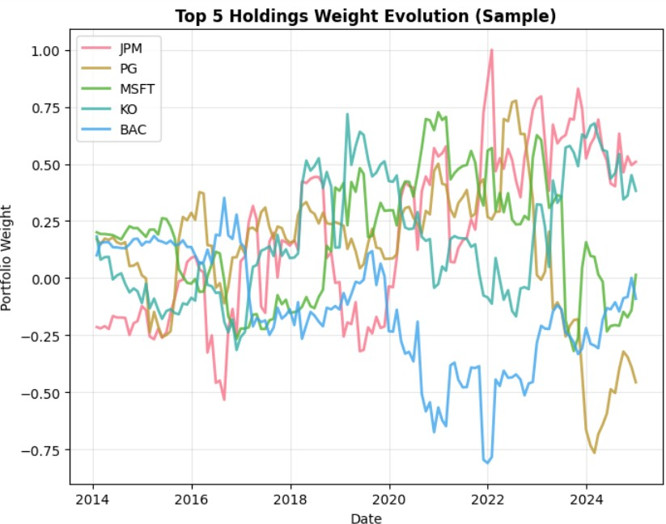
Portfolio Breakdown
Major oscillation in the top 5 holdings over the 15 years being tracked
The top weight in any period is as high as 100% in JPM around 2022

Slide 5
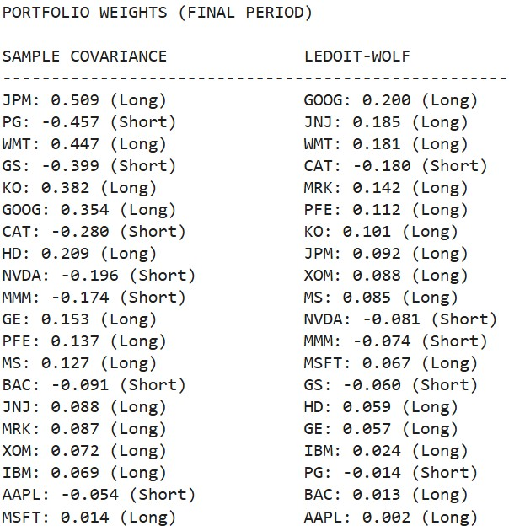
Portfolio Breakdown (Final Period)
Shrinkage at work:
Sample portfolio: 0.97 spread
L-W: 0.38 spread

Slide 6
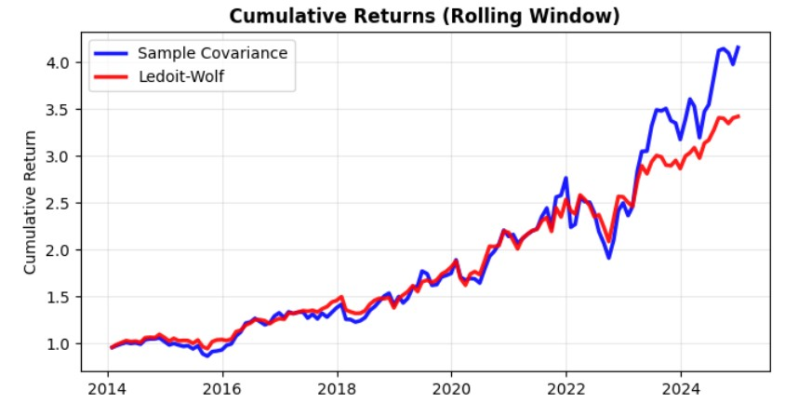
Portfolio Returns
Sample Portfolio
L-W Portfolio
Total Return: 315.79%
Total Return: 242.30%
Annualized Return:
13.83%
Annualized Return:
11.84%
Managed the 2020 downturn well and posted major gains in the 5 years after
Showed a steady 11% return over the 15 yr period

Slide 7
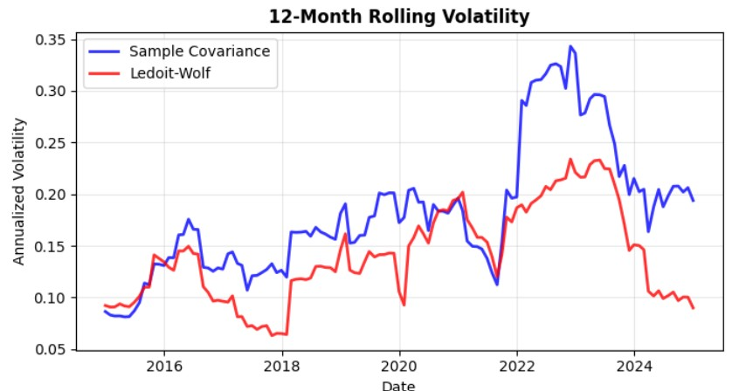
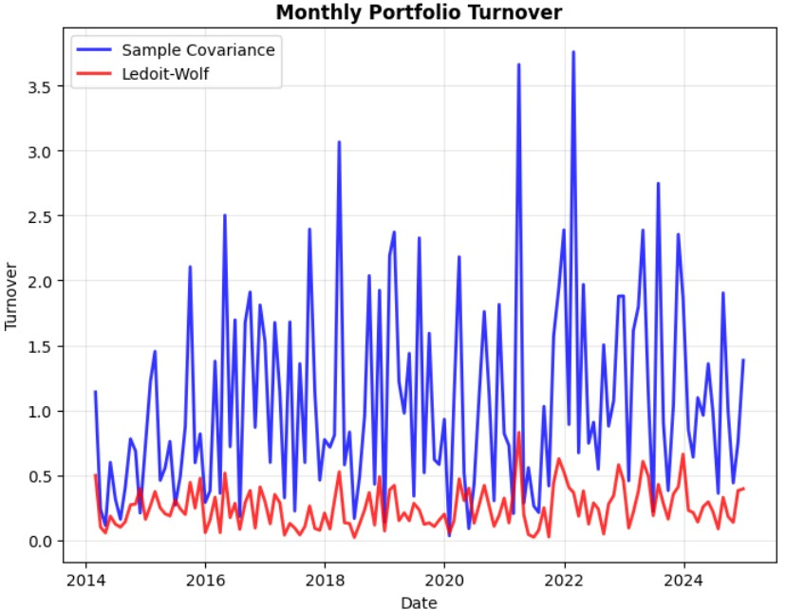
Portfolio Volatility & Turnover
We see major differences in both the volatility of the portfolios and the asset turnover
Volatility: the annualized volatility for the sample portfolio is 18.67% while the L-W volatility is 14.03% per year
Turnover: the median monthly turnover for the sample portfolio is 87.6% and the L-W is only 23.4%

Slide 8
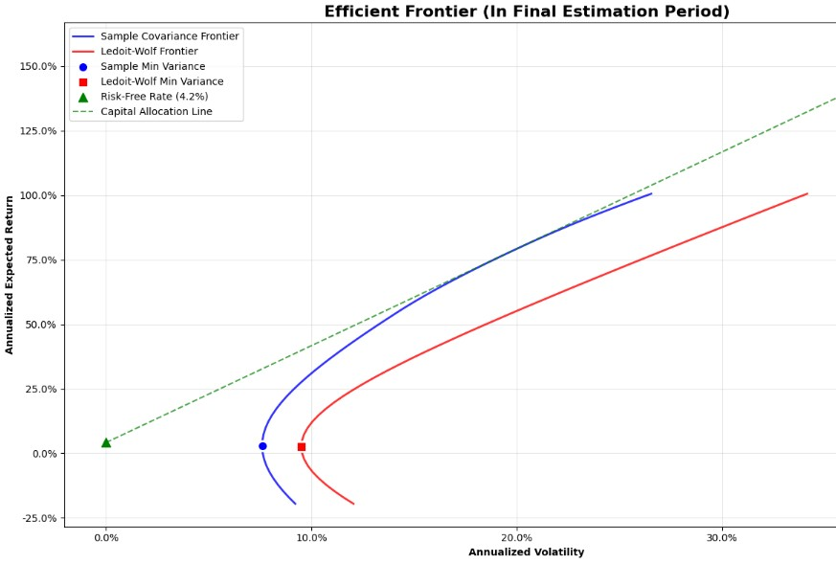
Efficient Frontier
Based on Final Portfolio Iteration
Risk free rate was 4.2%
Sample covariance frontier shows less volatility needed for a given return
L-W portfolio has a stable slope. What would the CAL look like?

Slide 9
Takeaways
Higher Returns, but at what cost
Transaction Cost Effect
The sample portfolio had about a 2% higher annualized return, but had 4.5% higher yearly volatility.
Our sample portfolio has a median monthly turnover of 87%, almost 4 times higher than the L-W portfolio (23%). After transaction costs, the net returns will be lower.
Given our portfolio assumptions, we found the sample covariance portfolio outperformed the Ledoit-Wolf portfolio, but with much higher variance and asset turnover. When presented to a client, there are a few major takeaways we would make sure to highlight when deciding which portfolio is best.
Finding a point on the CAL
Re-run with client parameters
After finding which portfolio works best for the client, we will discuss their risk tolerance and decide how much they want to invest in the risk free rate.
After discussing the strategy the client is interested in, we will re-run the model with their parameters to settle on a final portfolio.

Slide 10
Thank you!!
1 October 2025
Lehman Brothers 2.0

